Slide 1

Type of Trees

Slide 2
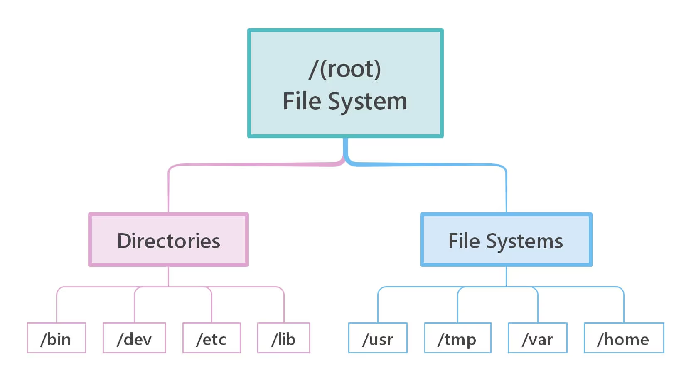
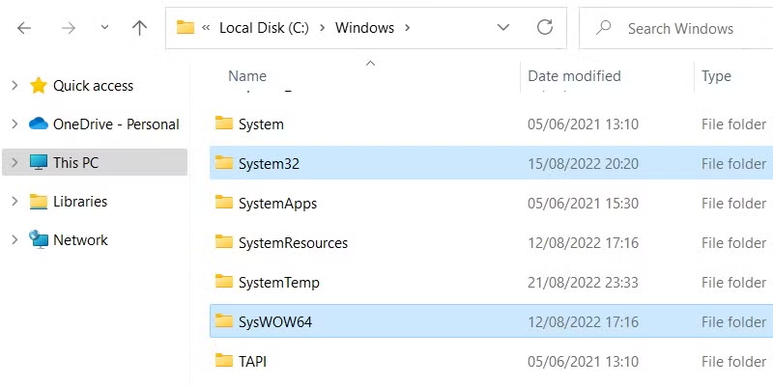
General Tree
A tree where each node can have any number of children.
Example: A file system where folders contain multiple subfolders or files.

Slide 3
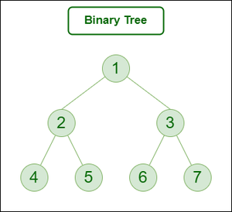
Binary Tree
A tree where each node has at most two children (left and right).
Example: Expression Tree.
Storing hierarchical data efficiently, used in parsing expressions, and game algorithms.

Slide 4
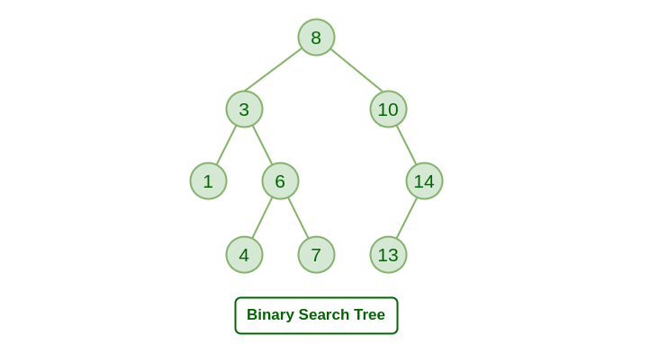
Binary Search Tree (BST)
A binary tree where:
The left subtree contains nodes with values less than the parent node.
The right subtree contains nodes with values greater than the parent node.
Efficient searching and sorting operations (O(log n))

Slide 5
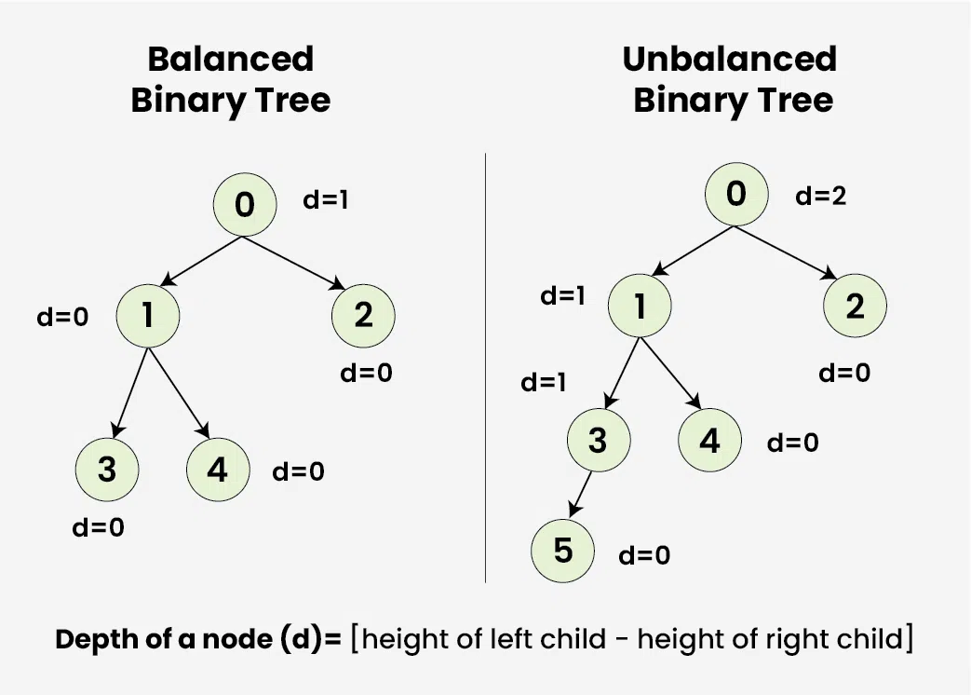
Balanced Binary Tree
A binary tree where the height difference between the left and right subtrees of any node is at most 1.
Maintains efficiency in operations like insertion, deletion, and lookup.

Slide 6
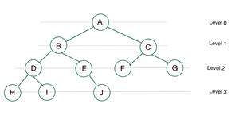
Complete Binary Tree
A binary tree where all levels are completely filled except possibly the last, which is filled from left to right.
Used in heaps, where the shape property ensures a balanced structure.

Slide 7
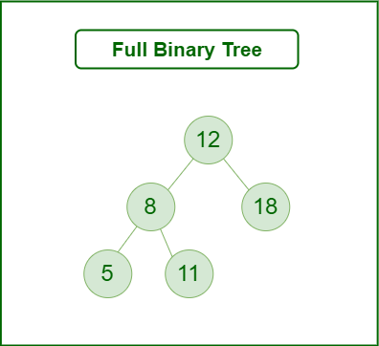
Full Binary Tree
A binary tree where every node has either 0 or 2 children.
Used in scenarios where all nodes have uniform branching, such as expression parsing.

Slide 8
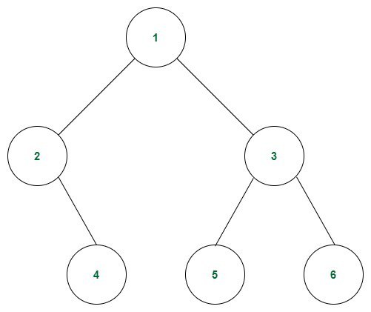
Perfect Binary Tree
A binary tree where all interior nodes have two children, and all leaf nodes are at the same level.
Efficient data storage and retrieval, such as decision trees.

Slide 9
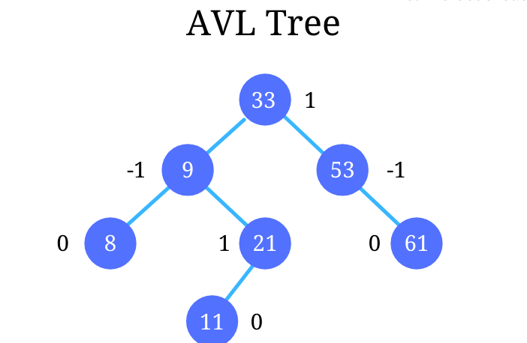
AVL Tree
A self-balancing binary search tree where the height difference between the left and right subtrees of any node is at most 1.
Ensures balanced trees for efficient searching, widely used in databases.

Slide 10
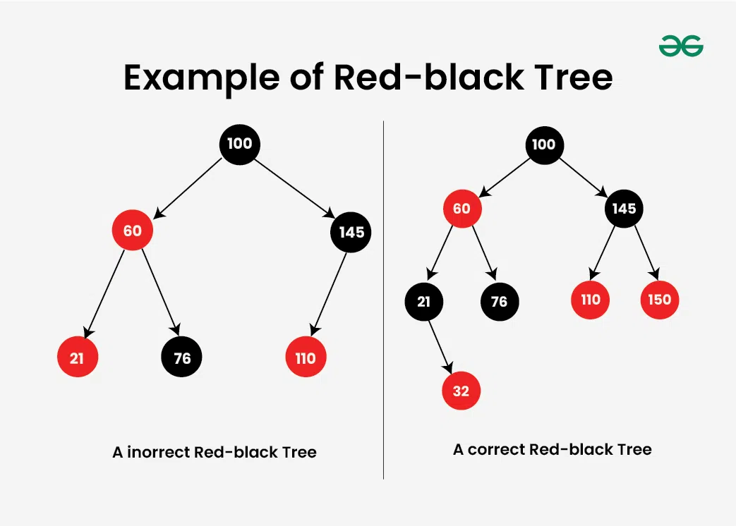
Red-Black Tree
A self-balancing binary search tree with the following properties:
Nodes are either red or black.
Root is black.
No two red nodes can be adjacent.
Every path from root to a leaf has the same number of black nodes.
Memory management in compilers, used in TreeMap and TreeSet in Java

Slide 11
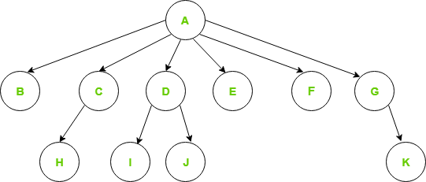
N-ary Tree
A tree where each node can have at most N children
Representing hierarchical structures like file systems.

Slide 12
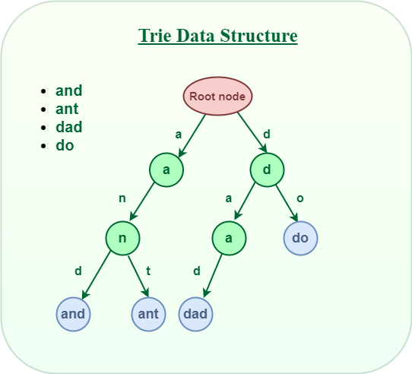
Trie (Prefix Tree)
A specialized tree for storing strings, where nodes represent characters, and paths represent words.
Used in autocomplete systems and dictionaries.

Slide 13
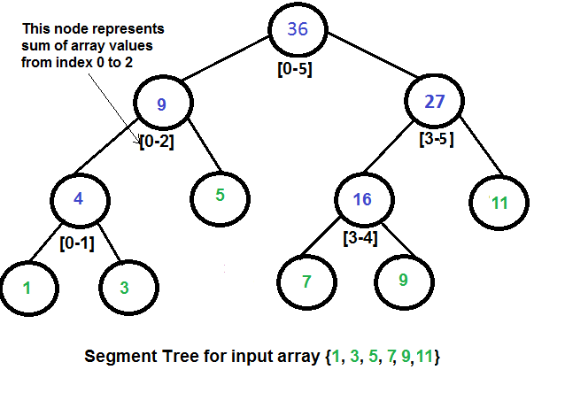
Segment Tree
A tree used to store intervals or segments for efficient range queries.
Range sum queries, range minimum/maximum queries.

Slide 14
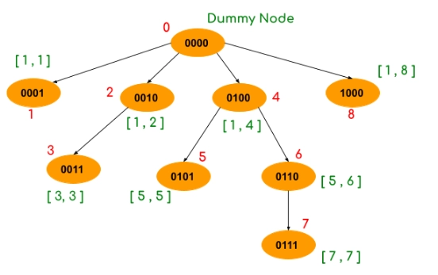
Fenwick Tree (Binary Indexed Tree)
A tree used for efficient prefix sum queries and updates.
Dynamic cumulative frequency tables.

Slide 15
Binary Trees
A Binary Tree is a hierarchical data structure in which each node has at most two children
1
2
3
4
5
6
Full Binary Tree- Every node has either 0 or 2 children.
Complete Binary Tree- All levels are completely filled except possibly the last, which is filled from left to right.
Perfect Binary Tree - All internal nodes have two children, and all leaf nodes are at the same level.
Balanced Binary Tree- The difference in height between left and right subtrees is at most 1.
Degenerate (Skewed) Tree Every parent node has only one child.

Slide 17
Traversal
Preorder Traversal (Root → Left → Right)
1
2
3
4
5
6
1 2 4 5 3 6

Slide 18
Traversal
Inorder Traversal (Left → Root → Right)
1
2
3
4
5
6
4 2 5 1 3 6

Slide 19
Traversal
Postorder Traversal (Left → Right → Root)
1
2
3
4
5
6
4 5 2 6 3 1

Slide 20
Traversal
Level Order- Level by Level (BFS)
1
2
3
4
5
6
1 2 3 4 5 6

Slide 21
Binary Search Tree
In this nodes are arranged in a specific order that allows efficient searching, insertion, and deletion operations.
Left child: Contains values smaller than the parent.
Right child: Contains values larger than the parent.
Unique Values: A BST does not allow duplicate values (in a standard implementation).
Recursive Structure: Every left and right subtree is also a BST.

Slide 22
Binary Search Tree
50
30
70
20
40
60
80

Slide 23
Important Points about BST
In this nodes are arranged in a specific order that allows efficient searching, insertion, and deletion operations.
Left child: Contains values smaller than the parent.
Right child: Contains values larger than the parent.
Unique Values: A BST does not allow duplicate values (in a standard implementation).
Recursive Structure: Every left and right subtree is also a BST.

